Slide 1
Stay Recommendations Programming for Big Data Analytics
Dhaval Patel (djp526)
Vishnu Thakral (vvt223)
Yash Rathod (yhr208)
Guided by : Prof. Juan Rodriguez

Slide 2
Problem Statement
Account for safety of the neighborhood and nearby facilities to recommended stay for the guest.
Predict rating for relatively new and unrated listings, thus bringing up the value of listings with good score potential.
2

Slide 3
Datasets used
Airbnb’s Listing Dataset : 50k (Active Listings in NYC)
NYC Crime Stats : 66M (10 years)
NYC Restaurant Dataset : 3M
3

Slide 4
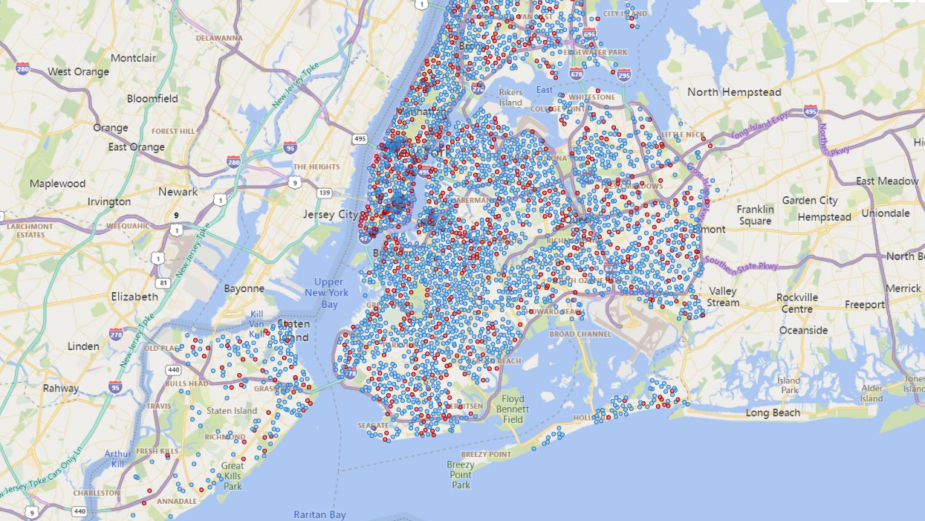
Insights on Airbnb’s listing Data (NYC)
Total available current listings : 50K
Total number of listings with less number of reviews/ratings( <15 ): 22K
Average New Listing added per month : 3K
4

Slide 5

Methodology
Present Month’s Listed Properties
Airbnb’s Listing Data
(Last 12 months)
Trained Model
(Logistic Regression)
Airbnb listings with crime and nearby facilities based on Geo-location
Pre-Processing
Feature Extraction
& Training
NYC Crime-stats Data
Listings with Updated Ratings
NYC Restaurant Data
5

Slide 6

Pre-Processing
Airbnb’s Listing Data
(Last 12 months)
Cleaned data with Unique Listings
Join based on geo-location
(To get crime-stats and restaurants within 0.5 miles of the property)
Logistic Regression
For Training
NYC Crime-stats Data
NYC Restaurant Data
6

Slide 7
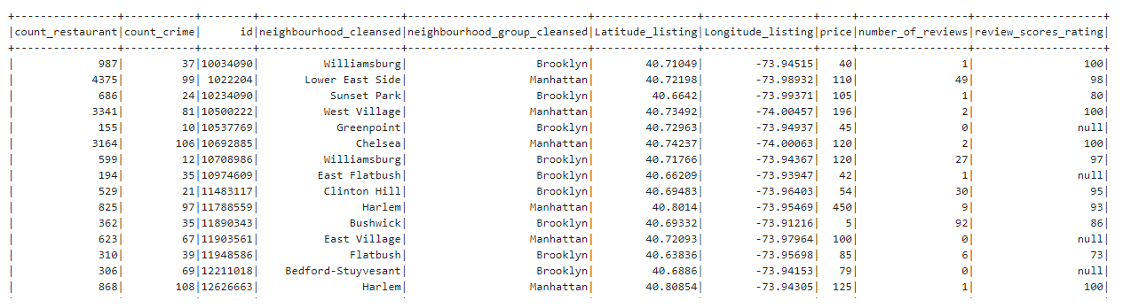
Dataset after Pre-Processing:

Slide 8
Model Training and Prediction
Listings with >15 reviews/ratings
Feature Extraction
& Training
Join based on geo-location
(To get crime-stats and restaurants within 0.5 miles of the property)
Listings with ≤ 15 reviews/ratings
Model
Prediction
(Updated Rating)
Accuracy
Transform
8

Slide 9
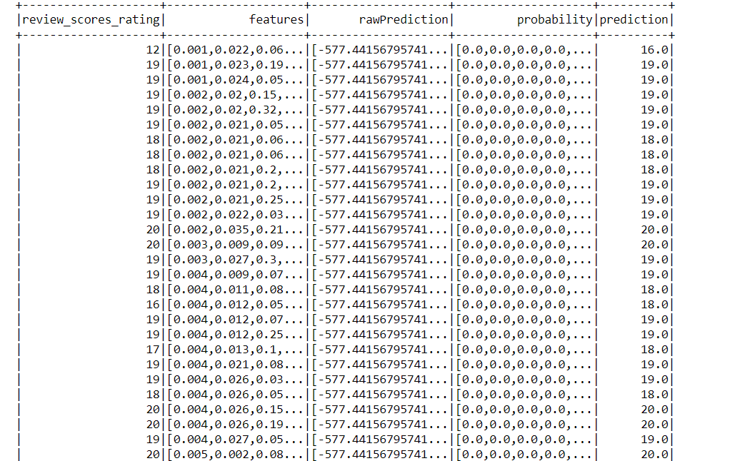
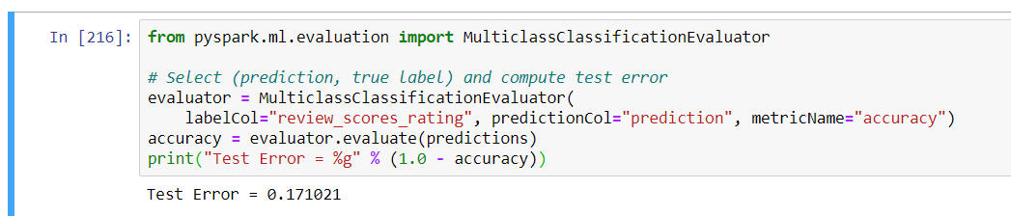
Dataset after Prediction:

Slide 10
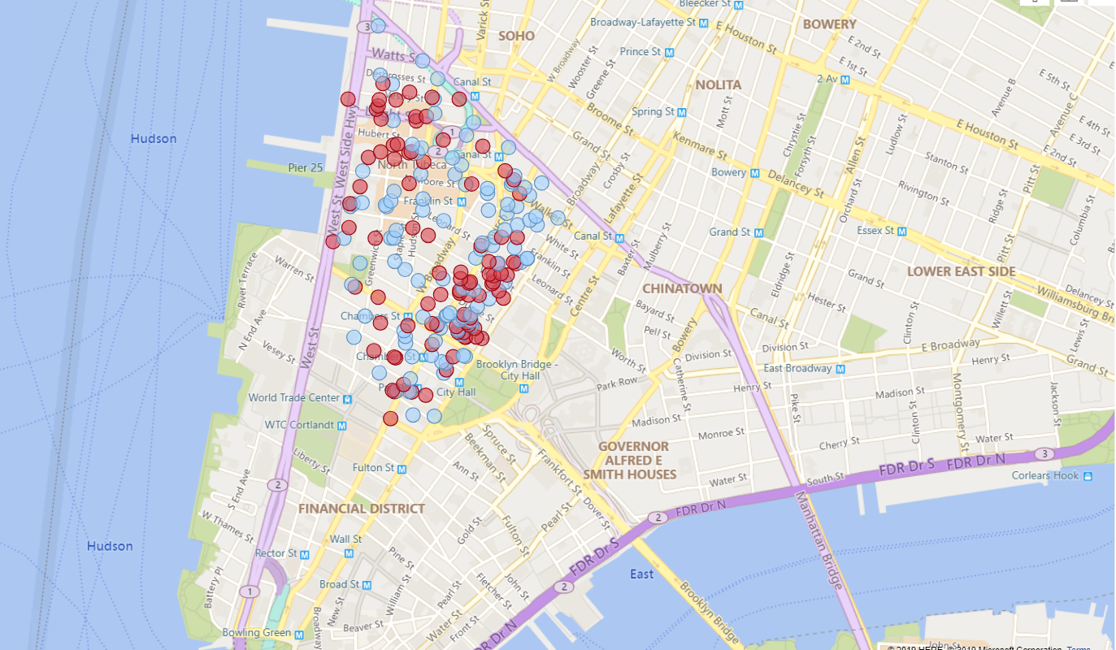


Power BI Map Visual
Area:
Tribeca, Manhattan
Listings with more than 15 reviews
Listings with less than 15 reviews
Listings with more than 15 reviews
Listings with less than 15 reviews

Slide 11
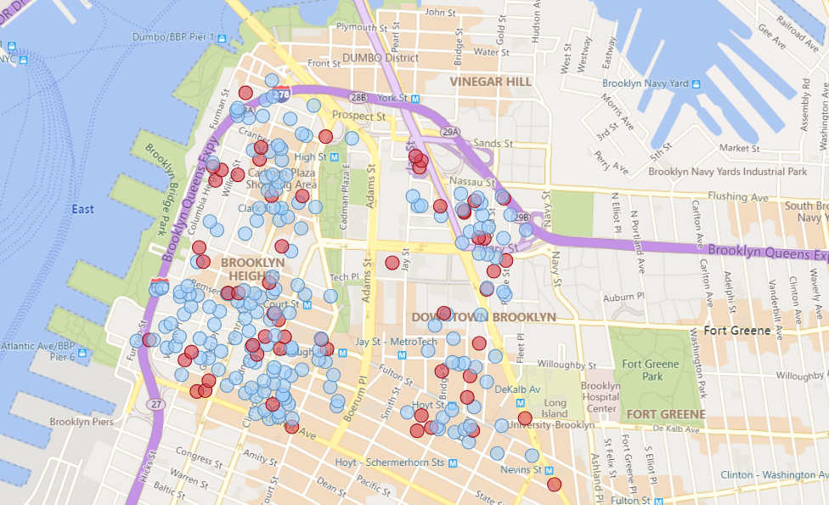
Power BI Map Visual
Area:
Downtown Brooklyn & Brooklyn Heights
Listings with more than 15 reviews
Listings with less than 15 reviews

Slide 12
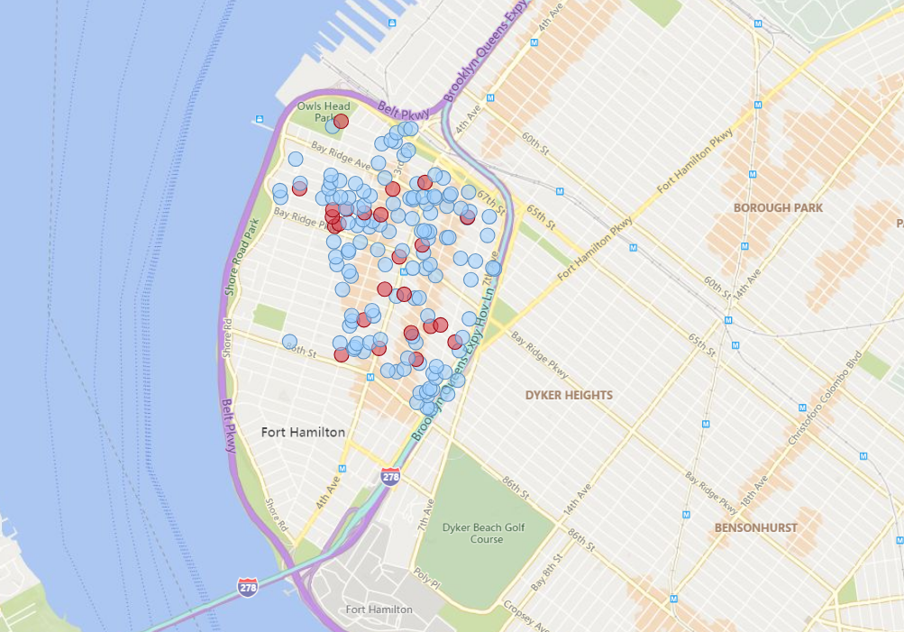
Power BI Map Visual
Area:
Bay Ridge, Brooklyn
Listings with more than 15 reviews
Listings with less than 15 reviews

Slide 13
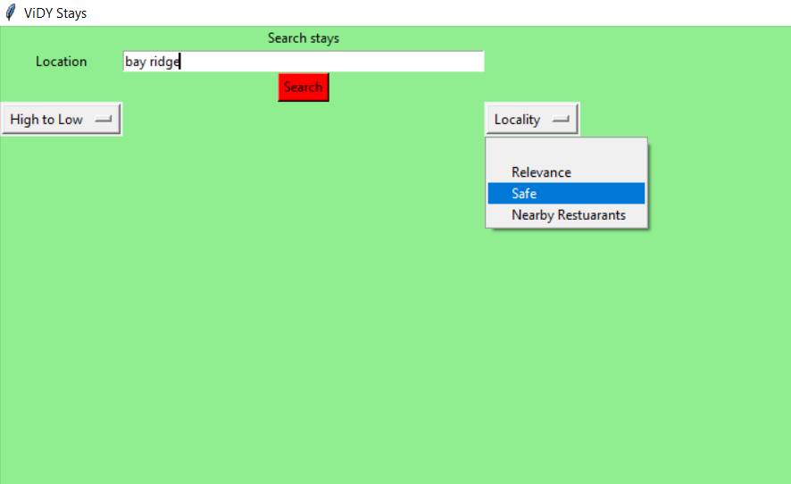
Demo
User Interface

Slide 14
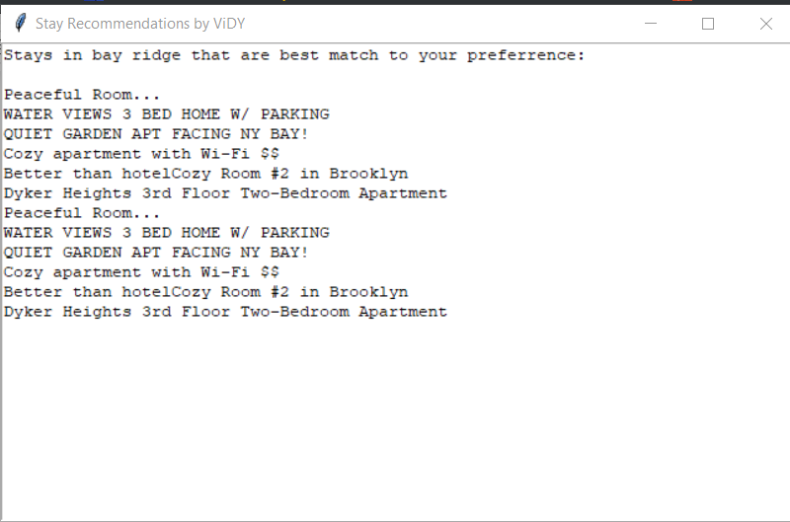
Demo
Search Output

Slide 15
Scalability in Production Environment
For each city, train and predict on stats specific to that location
Schedule model training & rating prediction task on a bi-weekly basis

Slide 16

Questions?

Slide 17
Thank you!

